Slide 1


PLEDGE TO PROGRESS Sustainability Hackathon
Sponsored By
Your Team Name: Helix
Your Team Bio:
Divyanshi, Harshada, Preeti & Snehal, we are passionate engineers who like to explore new technologies, develop quick and useful solutions for improving processes. Participating in hackathons give us opportunities to go beyond our office work and explore new ideas
Idea Name: Green IDE Extension
Date: 24-Apr-2023

Slide 2
Problem Statement?
Software Development can cause significant emissions which users are unaware of. The solution will monitor, estimate emissions and suggest actions to improve inefficiencies in process and reduce emissions.
In recent years the energy consumption of software have become an ever increasing environmental and societal concern.
Software developers often neglect the issue of considering the energy consumption impact of their software.
Promote sustainable development practices by increasing awareness of the environmental impact of software development.
This IDE extension will help make programmers make environmental friendly choices while programming.

Slide 3
User Segment & Pain Points
Which user /advertiser segment would be early adopter of your product & why?
Environmentally conscious developers
Developers working on energy-sensitive projects
Understand and report the emissions, actions taken, it is currently hard to capture consolidated information from programming
Organisations with sustainable goals

Slide 4
Pre-Requisite
What are the alternatives/competitive products for the problem you are solving?
There are very less initiative on this front
Not many tools are available in the market to address this issue
Found one research paper on the same https://projekter.aau.dk/projekter/files/422795208/Kandidat_Projekt__1_.pdf#page=38&zoom=100,281,529

Slide 5
Tools or resources
Azure tools or resources which are likely to be used by you for the prototype, if your idea gets selected
Azure Cloud
Azure Storage services like Blob Storage, Table Storage, or Azure SQL Database to store data generated by your extension, such as carbon emissions estimates, energy consumption data, or user preferences.
Azure DevOps for planning, collaborating, version control, Azure Boards for project management, Azure Pipelines for continuous integration and deployment of software projects.
Azure Monitor to monitor the performance and usage of the extension
Azure Virtual Machines to set up development and testing environments for the extension.

Slide 6
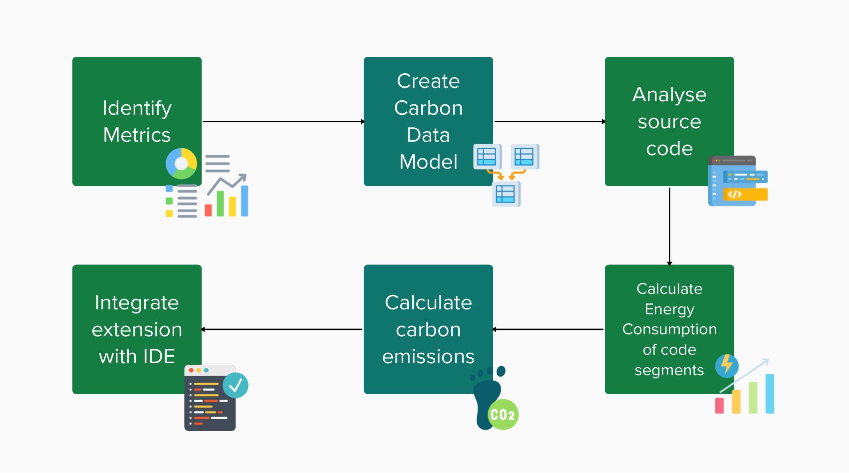
Proposed Solution
Research to select correct metrics: Investigate relevant metrics, such as CPU usage, Memory usage, Network I/Os and Disk I/Os, that contributes to the emission.
Create a carbon data model
Parse and analyse source code by identifying carbon intensive operations, e.g. loops, function calls, db queries, etc.
Calculate energy consumption of code segments
Calculate carbon emissions
Integration of extension with IDE

Slide 7
Key Differentiators & Adoption Plan
Key Differentiators
Contribution to green software development
Extensibility to compare the energy friendly code
Usage to estimate the energy consumption from software development
Not many existing tools in market to know carbon emissions of code segments
Adoption Plan
Plan to release Alpha version to 7 selected users to get feedback (5 Developers, 2 QA) - This version will be deployed on the resources used from Hackathon
Feedback will be based on Usability of interface and usefulness of insights generated - Incorporate feedback
For adoption of final version - Publish the version on open source GIT repo with detailed steps for integration and keep it open for community contribution

Slide 8
Thank You
Divyanshi Mangal
Harshada Modak
Preeti Solanki
Snehal Jagtap

